Slide 1
Java Programming

Slide 3
JAVA History
Java is just a name not an acronym. James Gosling, Mike Sheridan, and Patrick Naughton initiated the Java language project in June 1991. The small team of sun engineers called Green Team.
Firstly, it was called "Greentalk" by James Gosling and file extension was .gt. After that, it was called Oak and was developed as a part of the Green project.
Java is an Island of Indonesia where first coffee was produced.
Originally developed by James Gosling at Sun Microsystems (which is now a subsidiary of Oracle Corporation) and released in 1995.
There are many java versions that has been released.
JDK Alpha and Beta (1995)
JDK 1.0 (23rd Jan, 1996)
JDK 1.1 (19th Feb, 1997)
J2SE 1.2 (8th Dec, 1998)
J2SE 1.3 (8th May, 2000)
J2SE 1.4 (6th Feb, 2002)
J2SE 5.0 (30th Sep, 2004)
Java SE 6 (11th Dec, 2006)
Java SE 7 (28th July, 2011)
Java SE 8 (18th March 2014)

Slide 4
Types of java applications
Standalone applications – Desktop applications – AWT and SWINGS
Web applications - servlet, jsp, struts, jsf etc. technologies
Enterprise applications – Distributed applications-level security, load balancing and clustering - EJB
Mobile Applications - Android and Java ME
Currently Java is used in internet programming, mobile devices, games, e-business solutions etc.

Slide 5
Java 8 new features
Lambda Expression and Virtual Extension Methods
Highlighting feature of Java SE 8 is the implementation of Lambda expressions and supporting features to the Java programming language and platform.
Date and Time API
This new API will allow developers to handle date and time in a more natural, cleaner and easier to understand way.
Nashhorn JavaScript Engine
A new lightweight, high performance implementation of JavaScript engine is integrated to JDk and is available to Java applications via existing APIs.
Improved Security
Replacing the existing hand-maintained list of caller sensitive methods with a mechanism that accurately identifies such methods and allows their callers to be discovered reliably.

Slide 6
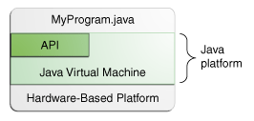
Java
Java is a programming language and a platform.
A Platform is hardware or software environment in which a program runs. Most popular platforms like Microsoft Windows, Linux, Solaris OS, and Mac OS.
Java is a software-only platform that runs on top of other hardware-based platforms.
The Java platform has two components:
The Java Virtual Machine
The Java Application Programming Interface (API)
API is grouped into libraries of related classes and interfaces; these libraries are known as packages.

Slide 7
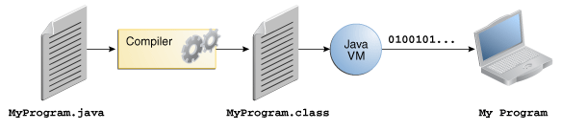
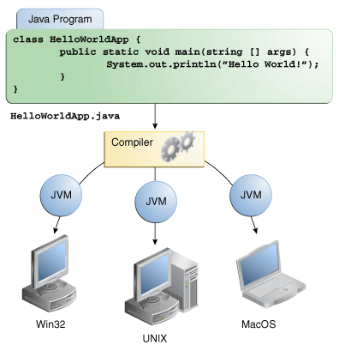
Java programming language
bytecode
The JVM performs following operation:
Loads code
Verifies code
Executes code
Provides runtime environment

Slide 8
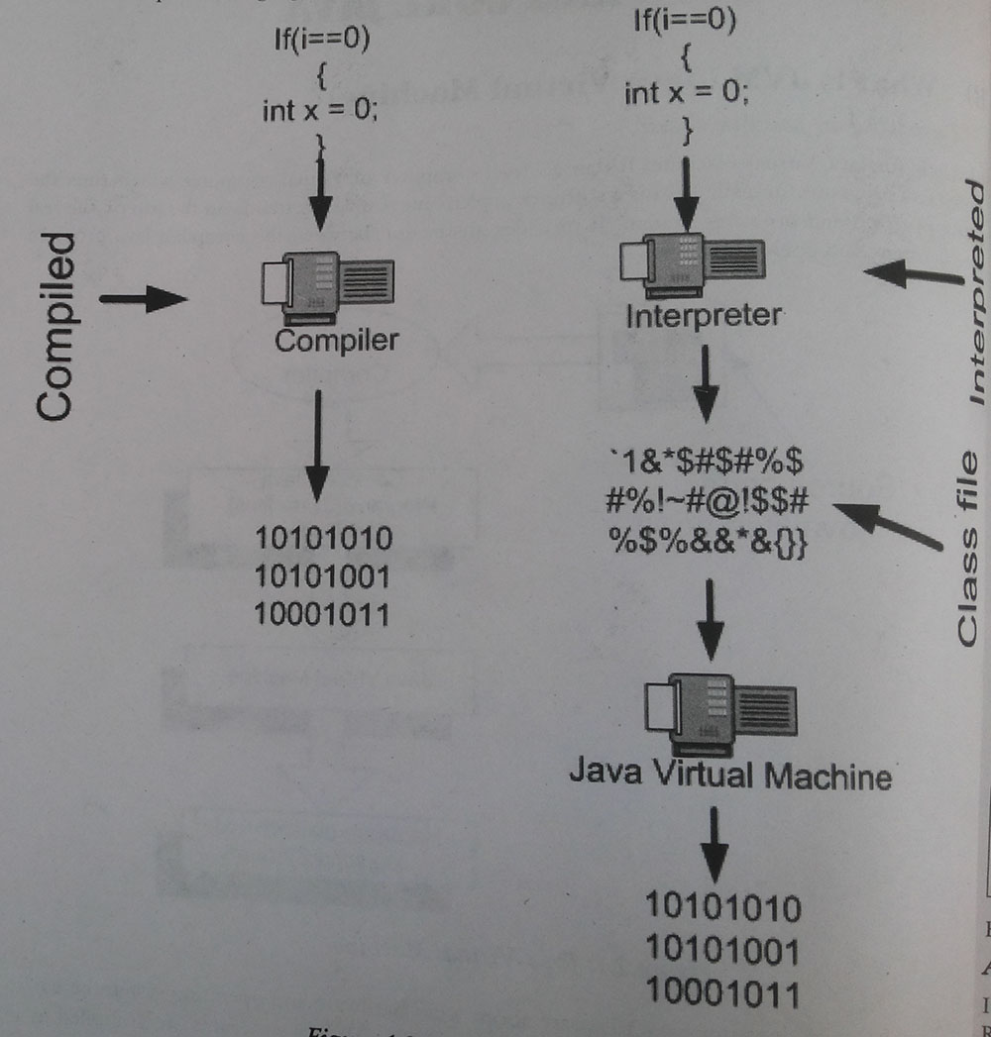
Difference between compiler and interpreter

Slide 9
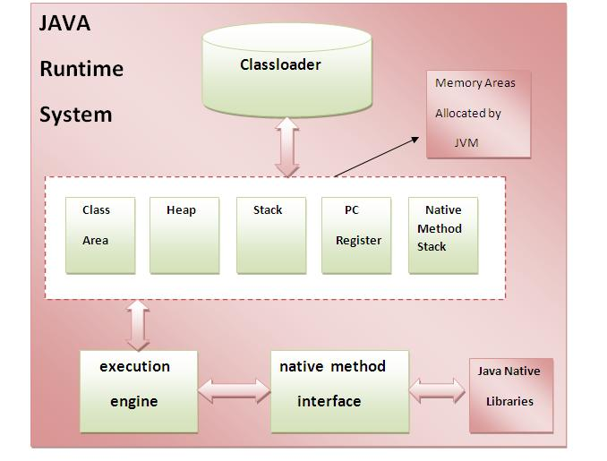
internal architecture of JVM
load class files
stores per-class structures such as the runtime constant pool, field and method data, the code for methods
native methods used in the application.
address of the Java virtual machine instruction currently being executed.
runtime data area in which objects are allocated.
Virtual processor, Interpreter + JIT compiler
Stores frames to hold local variables and partial results of a method in execution
Just-In-Time(JIT) compiler reads the bytecodes in many sections (or in full, rarely) and compiles them dynamically into machine language so the program can run faster.

Slide 10
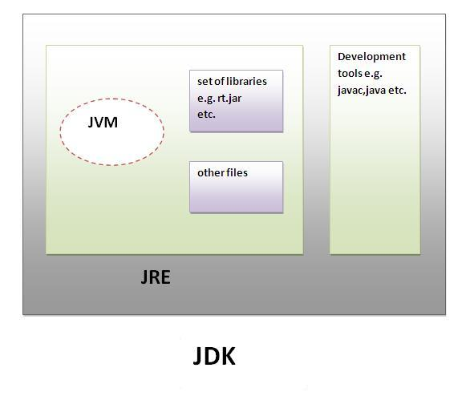
Difference between JDK, JRE and JVM
JVM : Java virtual machine
JRE : Java runtime environment
JDK: Java development Kit

Slide 11
Java features
Simple
Object oriented
Distributed
Multithreaded – concurrent programs
Dynamic
Architecture neutral
Portable
High performance
Robust – strong memory management
Secure

Slide 12
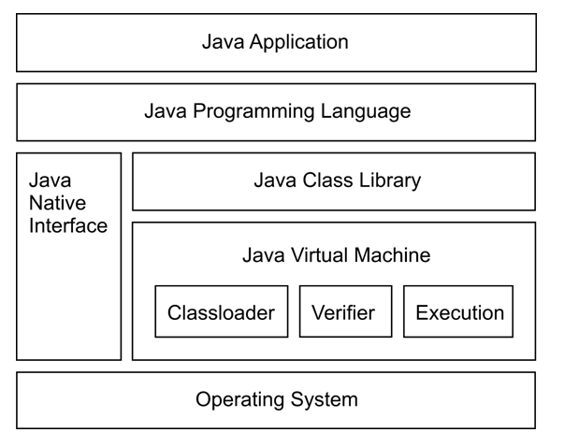
Java system overview

Slide 13
Differences between C++ and Java
C++ | JAVA
Not purely object oriented programming language | pure object oriented programming language
Platform dependent | Platform independent
Pointers are used | No pointers
Multiple inheritance | No Multiple inheritance
Supports Go to statement | Does not support Go to statement
Supports structure, union and operator overloading | Does not support structure, union and operator overloading
#define, typedef and header files are available | #define, typedef and header files are not available but there are means to achieve
Issues like memory leakage – allocating and deallocating of memory is the responsibility of the programmer | Automatic garbage collection – allocation and deallocation of memory will be taken care by JVM
Compiler programming language-compiled into native machine code, must be re-compiled for each target platform. | Compiler cum interpreter programming language
Supports 3 access specifiers private, public and protected | Supports 4 access specifiers private, public,protected and default
There are constructors and desctructors | Only constructors are available. No desctructors in java.
Supports only English language | Supports international languages using Unicode.

Slide 14
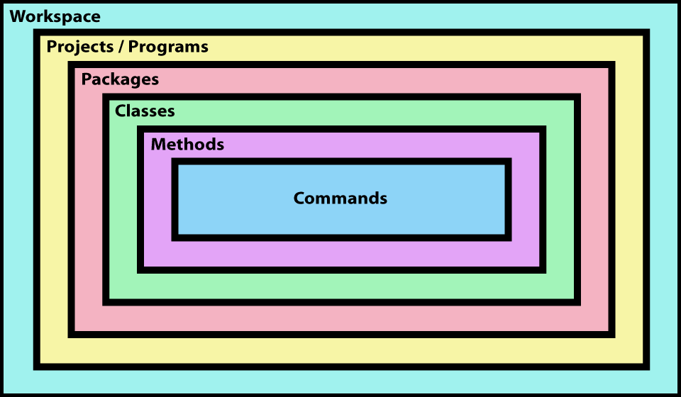
Anatomy of Java application

Slide 15
Structure of java program
// comments
package statement;
import statement;
class <ClassName>{// start with class
variables members
methods
public static void main(String[] args) //start with main point
{
statements
} // end main method
} // end class block

Slide 16
Java IDE
Eclipse –
Free download from www.eclipse.org
Netbeans -
Free download from https://netbeans.org/

Slide 17
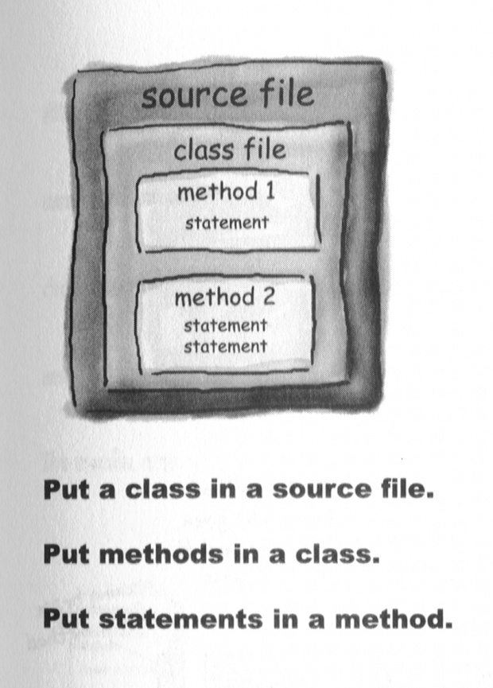
Java Code Structure --1

Slide 18
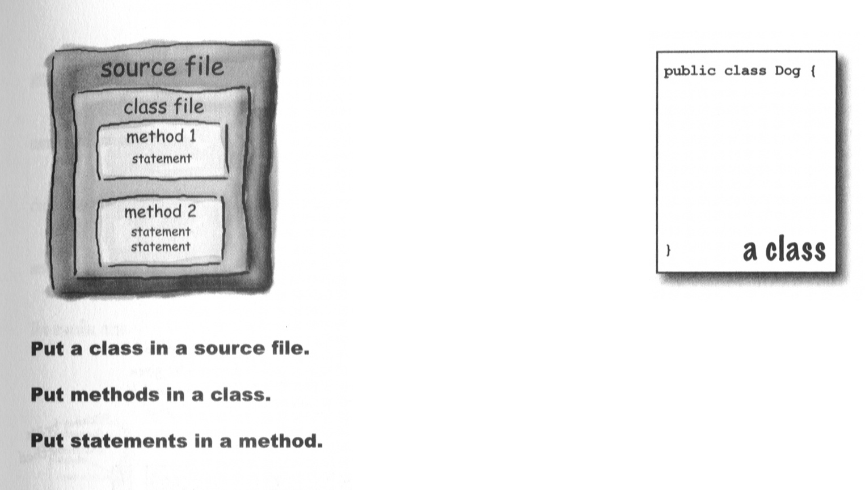
Java Code Structure--2

Slide 19
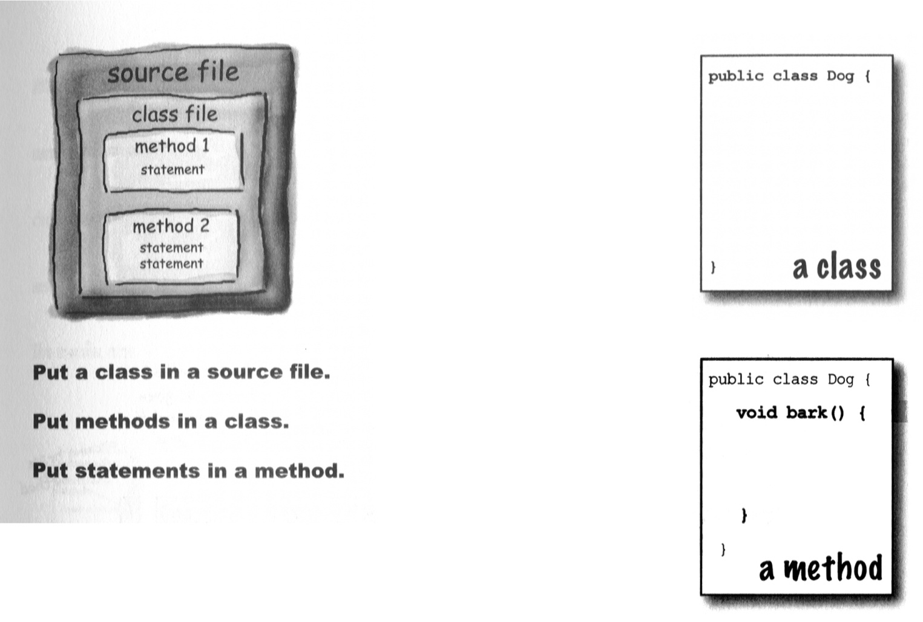
Java Code Structure --3

Slide 20
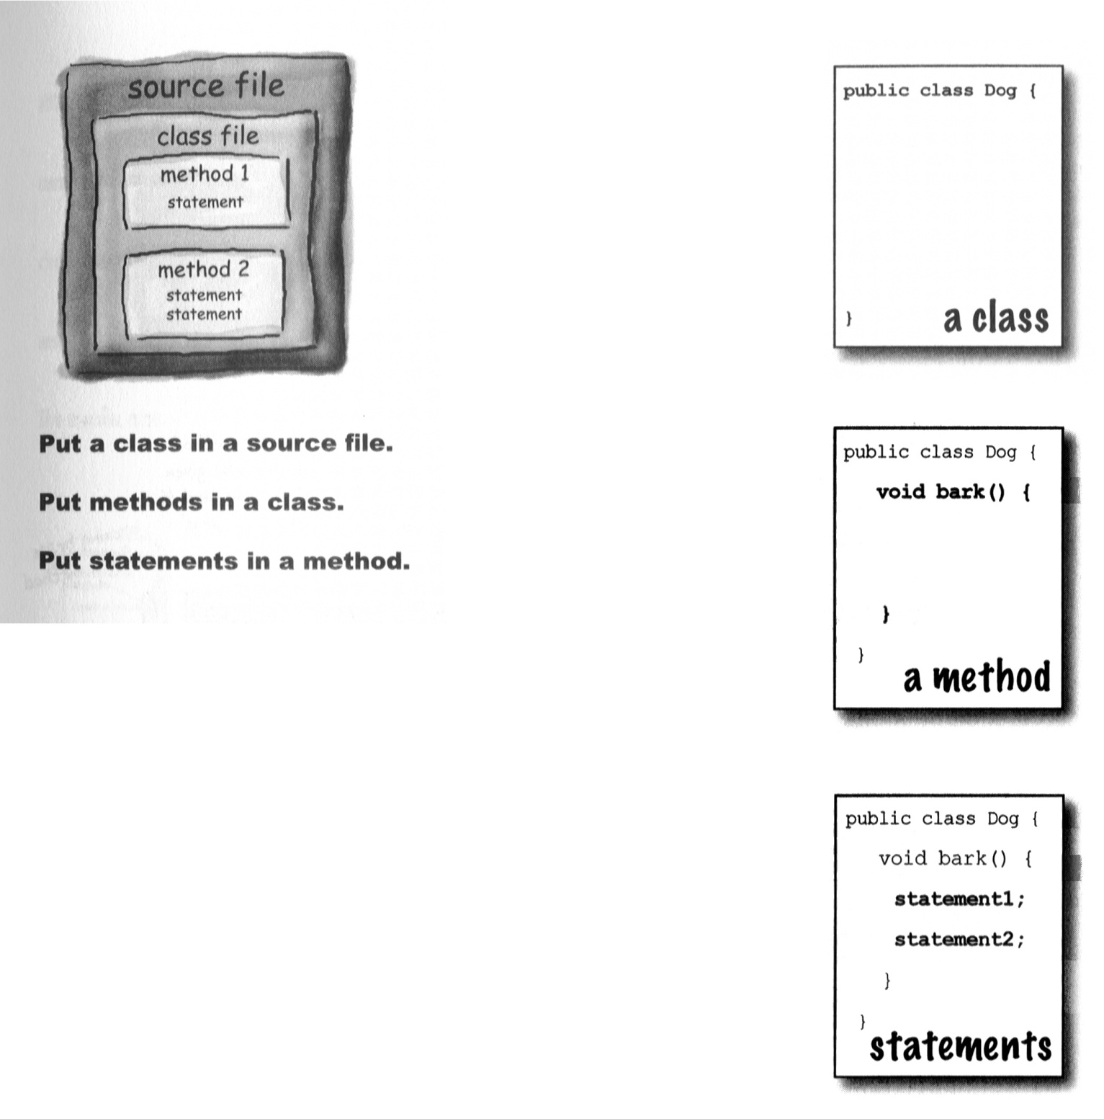
Java Code Structure –4

Slide 21
Statement
To display something on the monitor
print(“Welcome to Java”); A method should be called by using objectname.methodname()
PrintStream obj.print(“Welcome to Java”); Not possible to create object to PrintStream directly
System.out.print(“Welcome to Java”); System.out gives the PrintStream class object. It represents standard output device

Slide 22
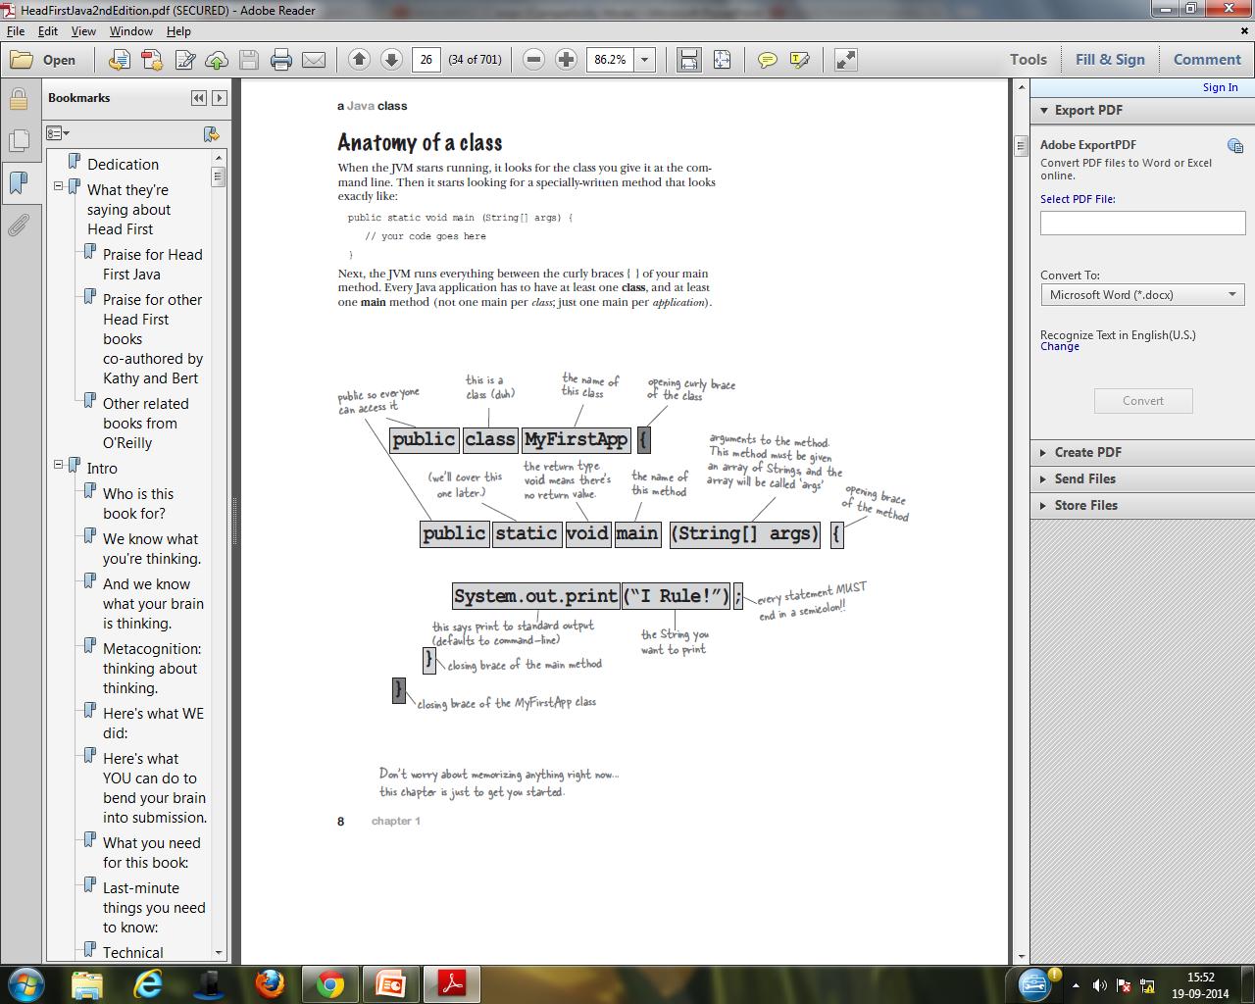
Anatomy of a class

Slide 23
Your First Cup of Java --1
public class HelloWorld
{
public static void main(String[] args)
{
System.out.println(“Hello World!");
}
}

Slide 24
Run JAVa program
Compile java program simple.java
C:\javac simple.java
Run simple java
C:\java simple
How to set Temporary Path of JDK in Windows
C:\set path=C:\Program Files\Java\jdk1.6.0_23\bin
How to set Permanent Path of JDK in Windows
Environment variables → create new user variable name “path” and set its value as path as C:\Program Files\Java\jdk1.6.0_23\bin
Set path in Unix
export PATH=$PATH:/home/jdk1.6.01/bin/

Slide 25
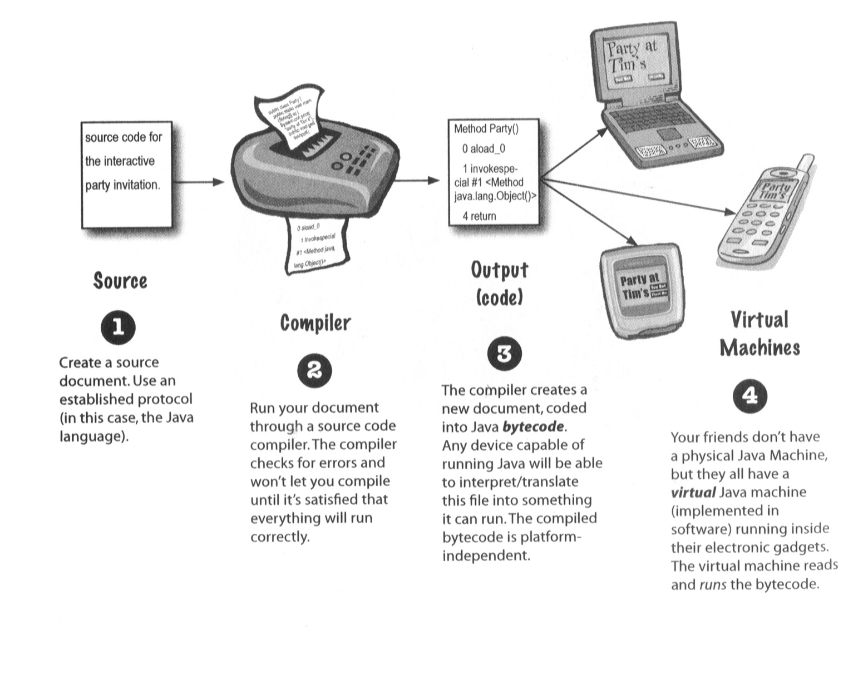
How Java Works --1

Slide 26
Classes & Objects
A class is a model for creating objects and does not exist physically. An object is anything that exists physically .Each java program has at least one class that knows how to do certain things or how to represent some type of object.
For example, the simplest class, helloworld,
Knows how to greet the world.
Classes in java may have methods (functions) and fields (attributes or properties).

Slide 27
class Cat
{
//instance variables(fields)
//methods
//constructors
}
Instance variables(fields) provides the state of the class and its objects
Methods to implement the behavior of the class and its objects
Constructors for initializing new objects, declarations for the fields.

Slide 28
Creating the objects
It has 3 steps
Declaration: Declaring a reference variable
Cat c = new Cat();
Instantiation: Creating an object The new keyword is used to create the object
Cat c = new Cat();
Initialization: Link the object and the reference. Calling the constructor.
Cat c = new Cat();
Where c – is the reference variable , which refers to the class- Cat

Slide 29
Create an object of a class
Syntax :
Classname objectname = new Classname();
Ex:
Class First
{
public static void main (String args[])
{
First obj = new First(); // Object is created hereafter JVM executes this.
}
}
Note : JVM calls main method using its class name as First.main() at the time of running the program.

Slide 30
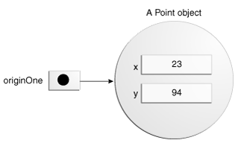
Declaring a Variable to Refer to an Object
type name;
Ex: Point originOne;
Initializing an Object
public class Point {
public int x = 0;
public int y = 0;
//constructor public
Point(int a, int b) {
x = a; y = b;
}
public static void main(String args[])
{
Point originOne = new Point(23, 94);
}
}
Referencing an Object's Fields
objectReference.fieldname //objectReference must be a reference to an object
Calling an Object's Methods
objectReference.methodName(argumentList);
or:
objectReference.methodName();

Slide 31
One more cup...
package com.dacstudent.test;
public class HelloWorld
{
public static void main(string[] args) {
helloworld hw = new helloworld();
hw.display();
}
public void display() {
system.out.println(“hello world”);
}
}
compile the program: javac HelloWorld.java
execute the program: java HelloWorld
output: hello world

